Slide 1
Generality and Generalisation in Principle and in Practice
Dr. Dennis Soemers
20 March, 2025
dennis.soemers@maastrichtuniversity.nl

Slide 2

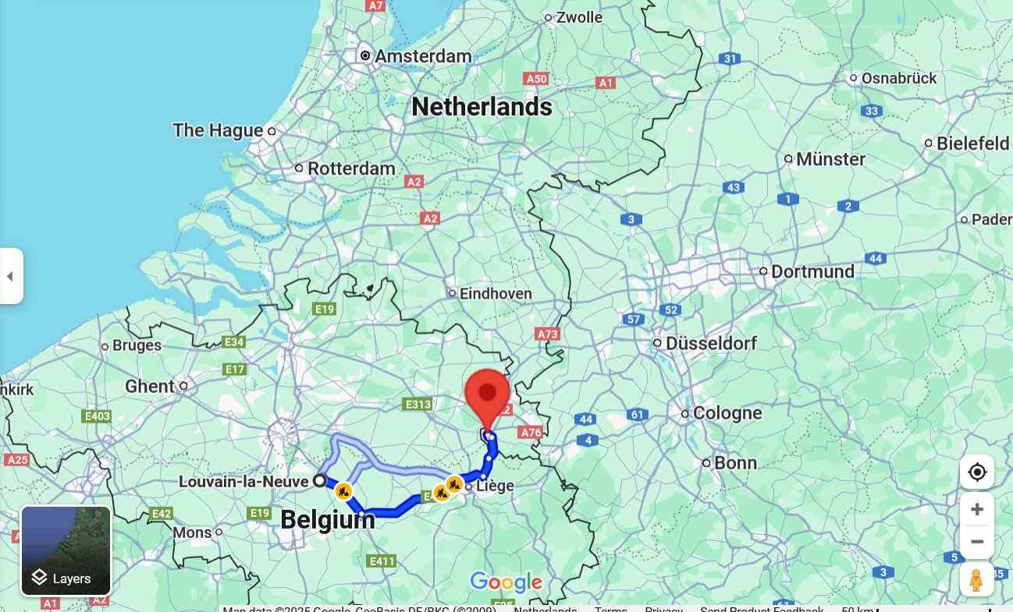
Who am I
Defended Ph.D. in April 2023
Assistant Professor at Maastricht University

Slide 3
Who am I
Defended Ph.D. in April 2023
Assistant Professor at Maastricht University
Main research interests:
Sequential decision-making AI
Reinforcement Learning
Tree search
AI for game playing

Slide 4
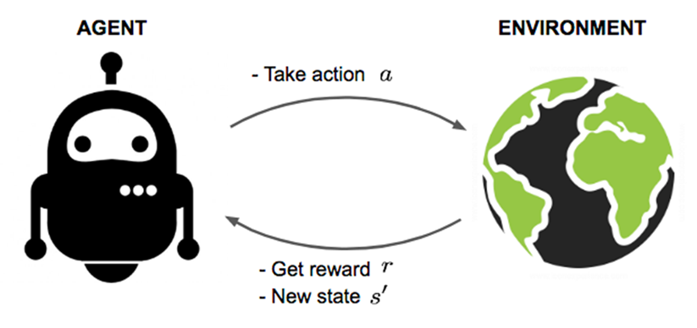
Markov decision processes (MDPs)

Slide 5
“Generality and Generalisation in Principle and in Practice”

Slide 6
“Generality and Generalisation in Principle and in Practice”
What do these two words mean in the context of Artificial Intelligence?

Slide 7
“Generality and Generalisation in Principle and in Practice”
There are differences between theory and practice…

Slide 8
Generality in AI

Slide 9
My definition of Generality in AI
“Generality” refers to the extent to which a technique can be applied to a variety of different problems.

Slide 10
My definition of Generality in AI
“Generality” refers to the extent to which a technique can be applied to a variety of different problems.
“Technique” may be an algorithm, machine learning model type, program, system, …

Slide 11
My definition of Generality in AI
“Generality” refers to the extent to which a technique can be applied to a variety of different problems.
“can be applied” does not necessarily require that it will actually work well

Slide 12
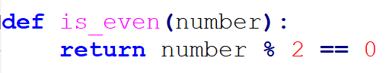
Generality: simple example
Quite a general function: can handle any (integer) number correctly

Slide 13
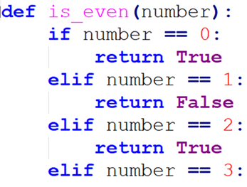
Generality: simple example
Quite a general function: can handle any (integer) number correctly
Not a very general function: can only handle inputs in {0, 1, 2, 3}

Slide 14
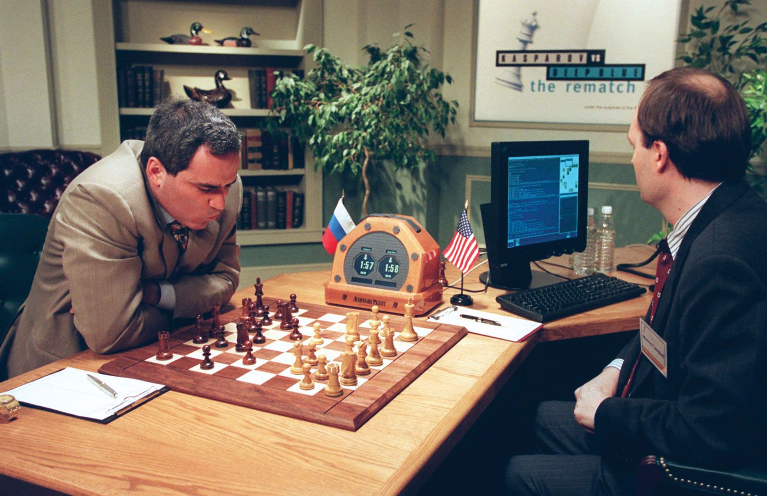
Generality vs. human-provided knowledge in AI
AI researchers usually perceive tension between (1) generality, and (2) injecting human-provided knowledge about how best to accomplish a task

Slide 15
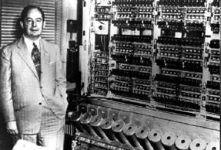
Minimax search (Von Neumann, 1928)
Max
Min
Max
3
4
2
7

Slide 16
Minimax search (Von Neumann, 1928)
Max
3
Min
Max
3
4
2
7

Slide 17
Minimax search (Von Neumann, 1928)
Max
3
2
Min
Max
3
4
2
7

Slide 18
Minimax search (Von Neumann, 1928)
3
Max
3
2
Min
Max
3
4
2
7

Slide 19
Heuristic state evaluation functions
When we can’t search the full space, we often combine a depth-limited search with a heuristic state evaluation function
3
Max
3
2
Min
Max
3
4
2
7

Slide 20
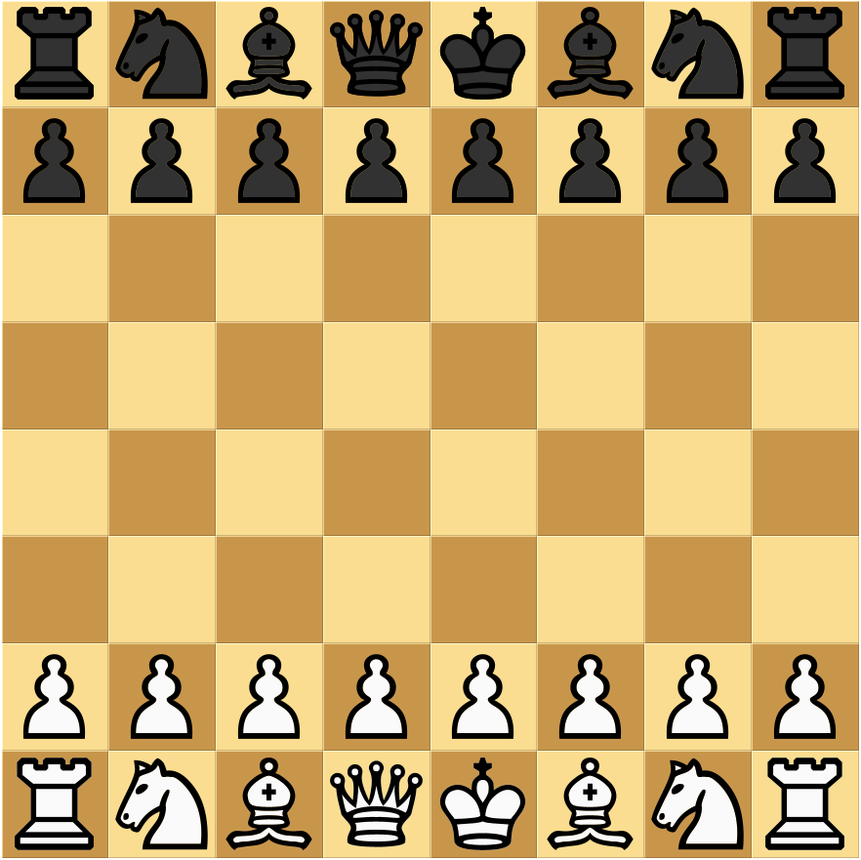
Heuristic evaluation function: Chess
Typical Chess heuristic evaluation function:
+1 point per Pawn
+3 points per Bishop
…
+9 points per Queen
…

Slide 21
Generality of Minimax + Heuristics
Minimax can be applied to any game
→ Quite general!

Slide 22
Generality of Minimax + Heuristics
Minimax can be applied to any game
(as long as it’s zero-sum, two-player, deterministic, sequential, and fully observable)
→ Quite general!

Slide 23
Generality of Minimax + Heuristics
Minimax can be applied to any game
(as long as it’s zero-sum, two-player, deterministic, sequential, and fully observable)
→ Quite general!
But: it requires a (game-specific) heuristic
(which was, historically, often programmed by hand)
→ Not very general?

Slide 24
Generality of Minimax + Heuristics
Minimax can be applied to any game
(as long as it’s zero-sum, two-player, deterministic, sequential, and fully observable)
→ Quite general!
But: it requires a (game-specific) heuristic
(which was, historically, often programmed by hand)
→ Not very general?
This is an issue at the level of system, not algorithm!

Slide 25
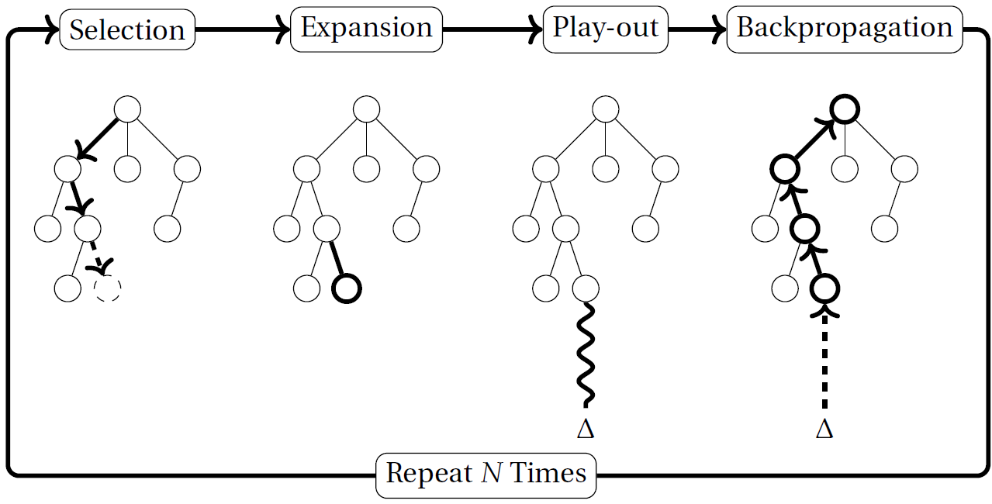
Monte-Carlo tree search (MCTS)

Slide 26
Generality of MCTS
MCTS estimates value from random play-outs instead of game-specific heuristic
→ more general!

Slide 27
Generality of MCTS
MCTS estimates value from random play-outs instead of game-specific heuristic
→ more general!(?)
Only really a difference in generality in practice, but not in principle

Slide 28
Generality of MCTS
MCTS estimates value from random play-outs instead of game-specific heuristic
→ more general!
MCTS is directly applicable in problems with 1 agent, with more than 2 agents, non-zero-sum domains, stochastic domains, …

Slide 29
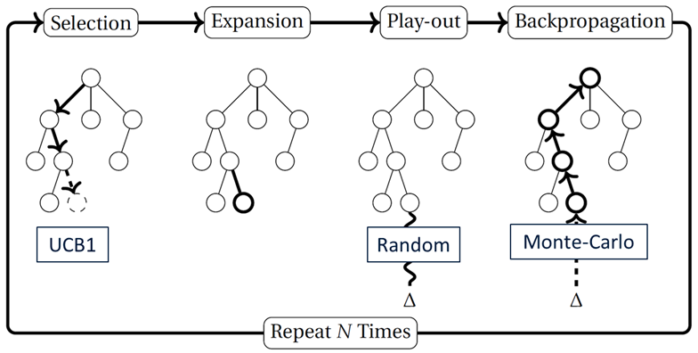
MCTS + Deep Learning
Pure “vanilla” MCTS is often kind of bad though

Slide 30
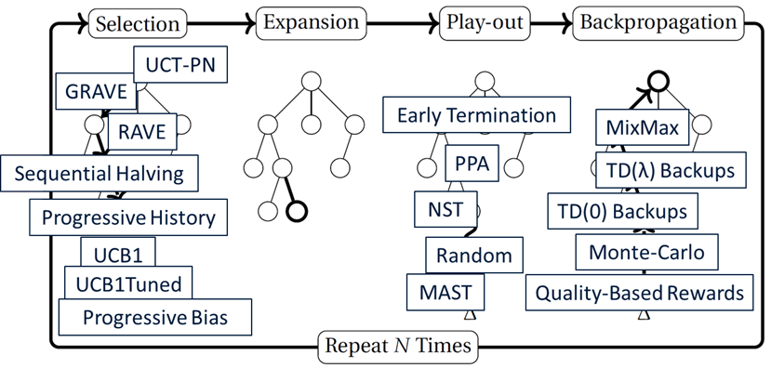
MCTS + Deep Learning
Pure “vanilla” MCTS is often kind of bad though
Many dozens of variants → reduces practical generality?

Slide 31
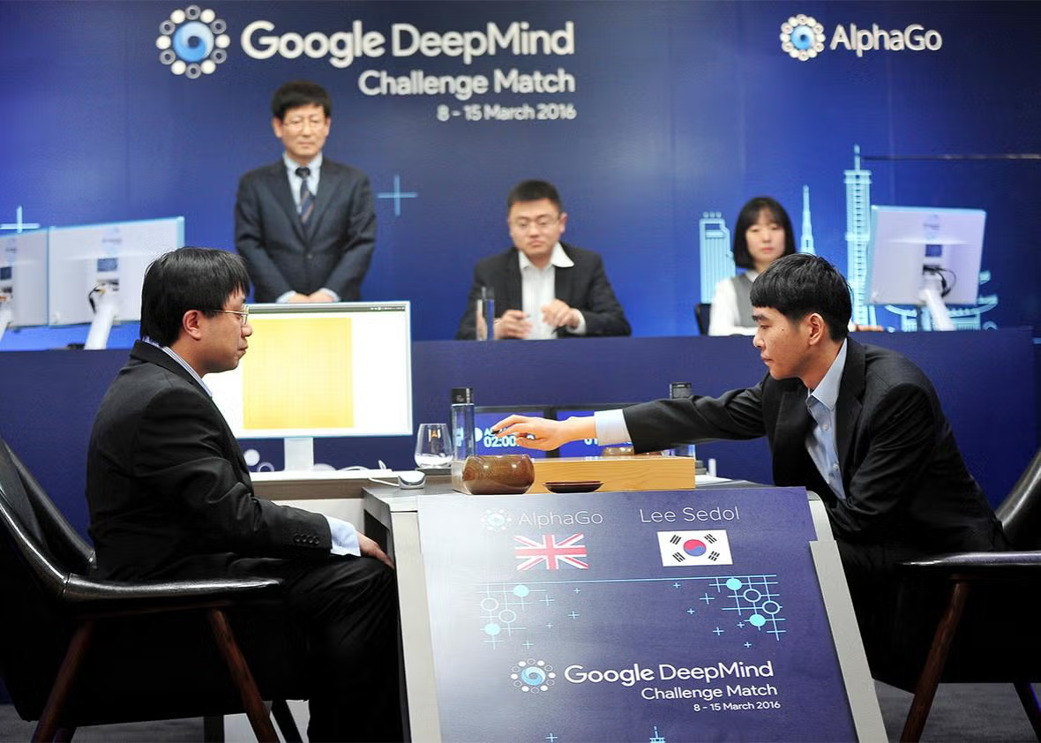
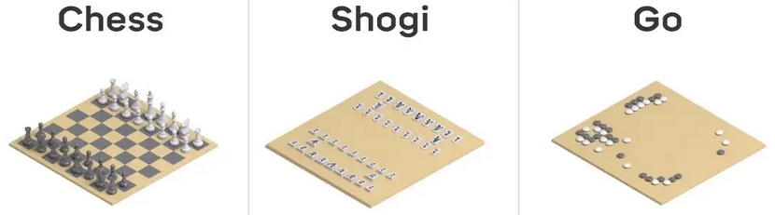
MCTS + Deep Learning
Pure “vanilla” MCTS is often kind of bad though
Many dozens of variants → reduces practical generality?
AlphaZero: MCTS + Deep Learning

Slide 32
AlphaZero: Zero knowledge?
“[...] given no domain knowledge except the game rules, AlphaZero convincingly […]”
This is a quote from the abstract of the AlphaZero publication in Science

Slide 33
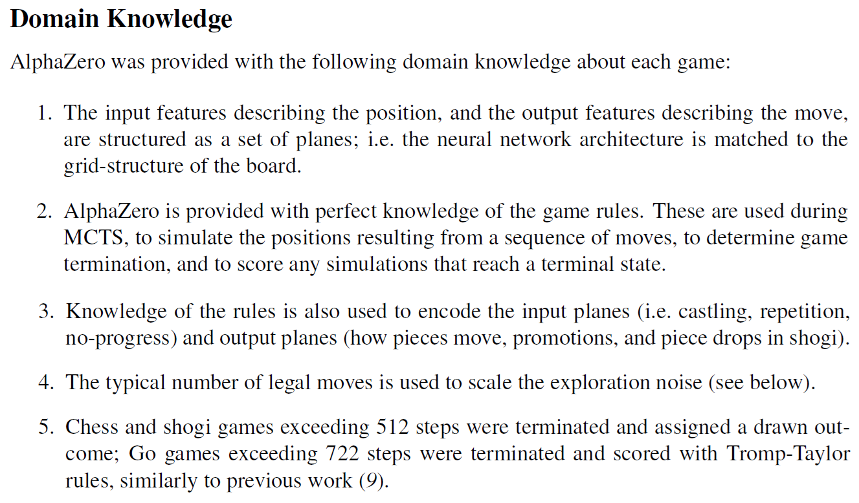
AlphaZero: Zero knowledge?
This is buried in the supplementary material of the same publication!

Slide 34
AlphaZero: Zero knowledge?

Slide 35
Artificial General Intelligence

Slide 36
Artificial General Intelligence (AGI)
But Dennis, what about Artificial General Intelligence (AGI)???

Slide 37
Artificial General Intelligence (AGI)
But Dennis, what about Artificial General Intelligence (AGI)???
Dennis: “please get me out of here, I don’t want to talk about AGI!”

Slide 38
AGI: definitions
As many definitions of AGI around nowadays as there are self-proclaimed AGI researchers

Slide 39
AGI: definitions
As many definitions of AGI around nowadays as there are self-proclaimed AGI researchers
I don’t really know any of them

Slide 40
AGI: definitions
As many definitions of AGI around nowadays as there are self-proclaimed AGI researchers
I don’t really know any of them
My informal definitions:
AGI = software that can autonomously perform any arbitrary, self-directed task

Slide 41
AGI: definitions
As many definitions of AGI around nowadays as there are self-proclaimed AGI researchers
I don’t really know any of them
My informal definitions:
AGI = software that can autonomously perform any arbitrary, self-directed task
AGI = human born after artificial insemination

Slide 42
Defining the scope
AGI = software that can autonomously perform any arbitrary, self-directed task
What we can expect an agent to do depends on:

Slide 43
Defining the scope
AGI = software that can autonomously perform any arbitrary, self-directed task
What we can expect an agent to do depends on:
What are its affordances?
What and how can it observe?
What environment does it live in?

Slide 44
Defining the scope
AGI = software that can autonomously perform any arbitrary, self-directed task
What we can expect an agent to do depends on:
What are its affordances?
What and how can it observe?
What environment does it live in?
We should define the scope within which we care about generality!

Slide 45
Large Language Models: path to AGI?
Environment:
Observations:
Affordances:

Slide 46
Large Language Models: path to AGI?
Environment:
Digital (single computer? Network?)
Observations:
Affordances:

Slide 47
Large Language Models: path to AGI?
Environment:
Digital (single computer? Network?)
Observations:
Read text (prompts, possibly files)
Affordances:

Slide 48
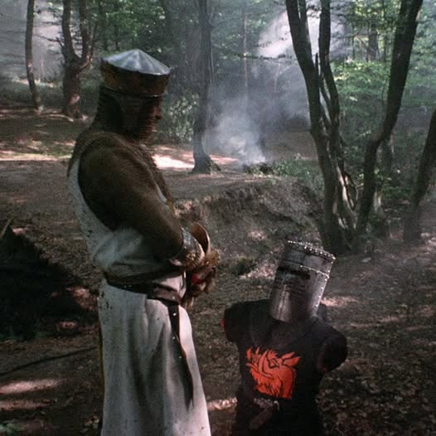
Large Language Models: path to AGI?
Environment:
Digital (single computer? Network?)
Observations:
Read text (prompts, possibly files)
Affordances:
Output text
Source: Monty Python and the Holy Grail

Slide 49
Large Language Models: path to AGI?
Environment:
Digital (single computer? Network?)
Observations:
Read text (prompts, possibly files)
Affordances:
Output text
Write and execute code?
Source: Monty Python and the Holy Grail

Slide 50
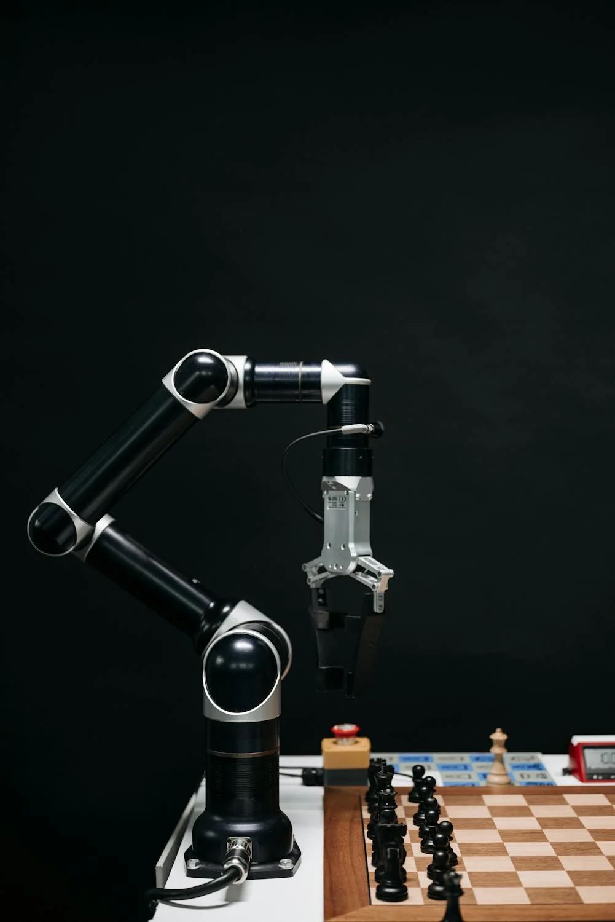
Robotics researchers are perfect
Environment:
Observations:
Affordances:

Slide 51
Robotics researchers are perfect
Environment:
Physical world (or simulation)
Observations:
Affordances:

Slide 52
Robotics researchers are perfect
Environment:
Physical world (or simulation)
Observations:
Determined by sensors on the robot
Affordances:

Slide 53
Robotics researchers are perfect
Environment:
Physical world (or simulation)
Observations:
Determined by sensors on the robot
Affordances:
Determined by motors / actuators / sound emitters on the robot

Slide 54
Generality in Task Modelling

Slide 55
Task modelling
Before we can apply AI to a task, we need to model the task
Build simulator
Design input → AI → output → do something pipeline
Define (formally) the objective / reward function

Slide 56
Markov decision processes (MDPs)

Slide 57
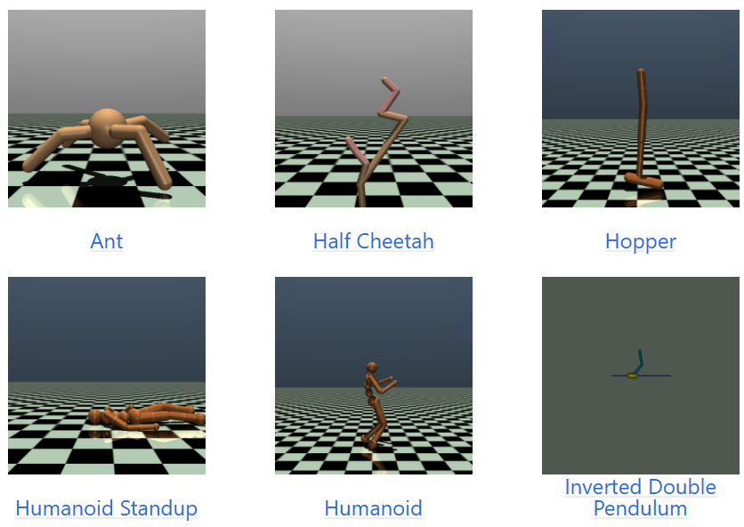
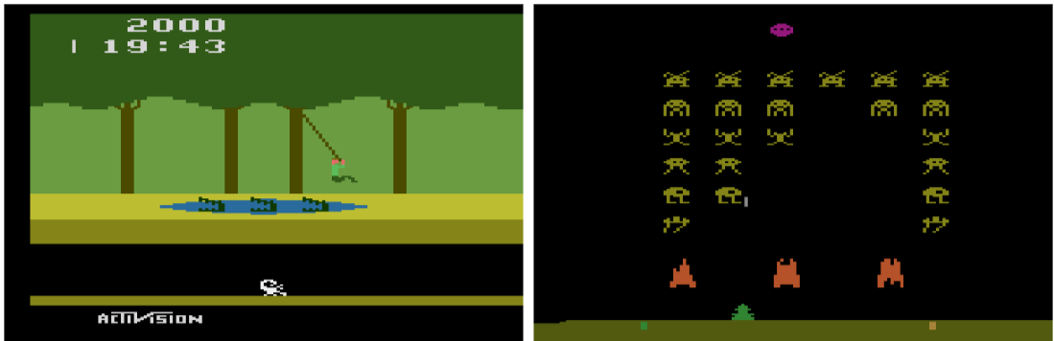
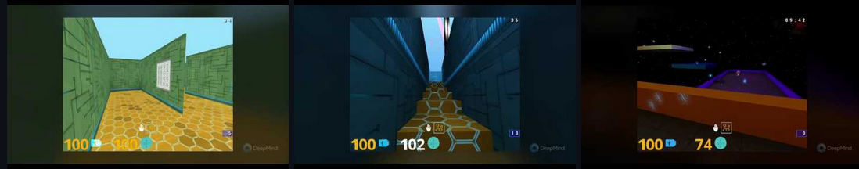
Benchmark collections (Reinforcement Learning)

Slide 58
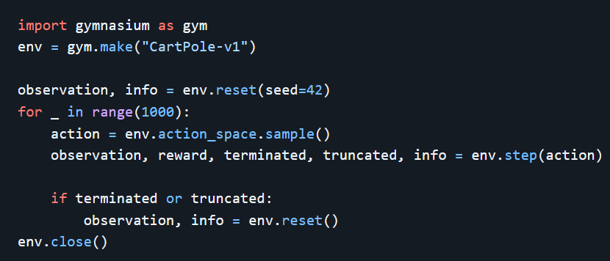
Gymnasium API

Slide 59
Gymnasium API
Instantiate the environment (the game / simulation / …)

Slide 60
Gymnasium API
Select an action to execute in the environment

Slide 61
Gymnasium API
A programmer is expected to hardcode what the action space of the environment is

Slide 62
Gymnasium API
Execute action, causing transition to next state

Slide 63
Gymnasium API
A programmer is expected to hardcode the dynamics (rules of the game, laws of physics, …)

Slide 64
Barriers to Widespread Use of RL
Suppose that I:
have an interesting sequential decision-making problem
do not have the programming expertise to build a correct simulator

Slide 65
Barriers to Widespread Use of RL
Suppose that I:
have an interesting sequential decision-making problem
do not have the programming expertise to build a correct simulator
I can’t use RL to train a policy for my problem ☹

Slide 66
Barriers to Widespread Use of RL
Suppose that I:
do have all the necessary engineering expertise
have a very large number of problems of interest
e.g., I want to study the >1000 board games played by humanity throughout history

Slide 67
Barriers to Widespread Use of RL
Suppose that I:
do have all the necessary engineering expertise
have a very large number of problems of interest
e.g., I want to study the >1000 board games played by humanity throughout history
Same problem!

Slide 68
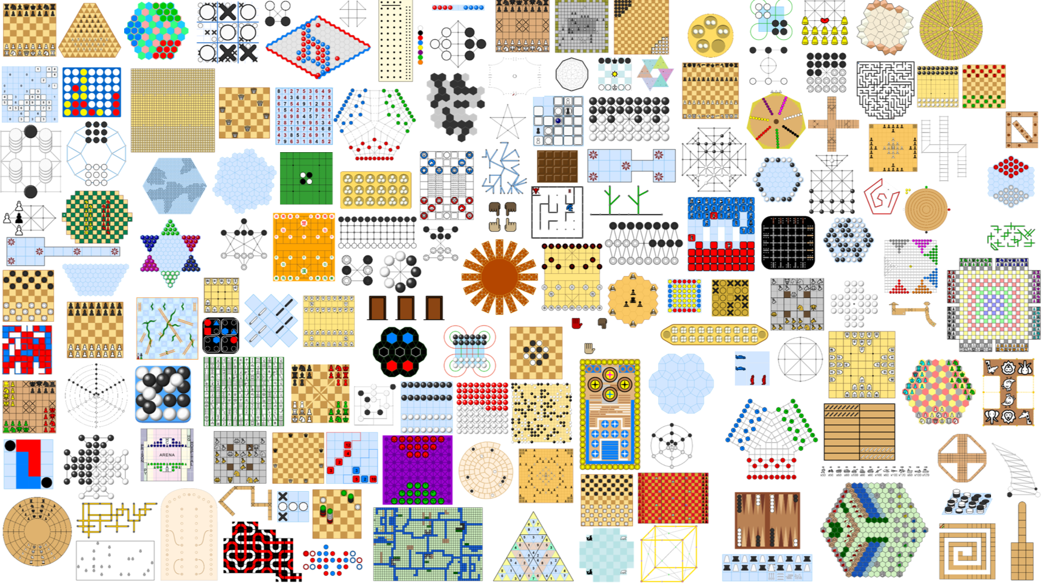

Slide 69
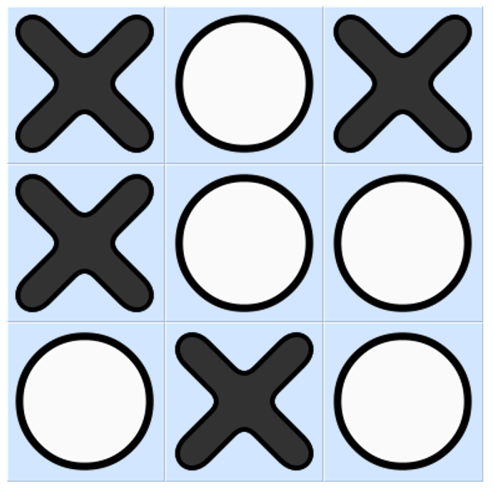
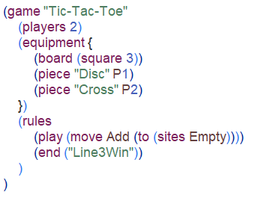
Ludii’s Game Description Language

Slide 70
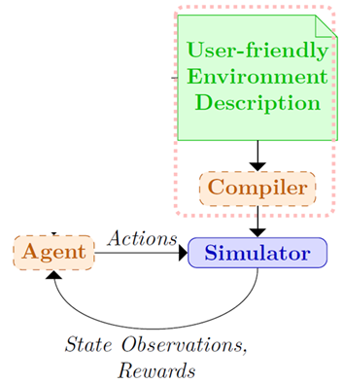
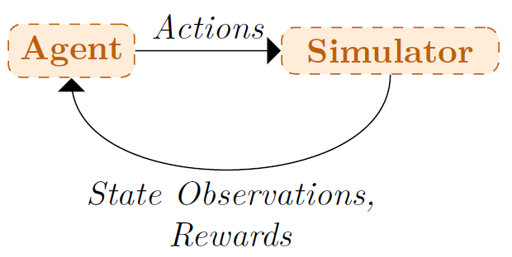
Environment Descriptions

Slide 71
Environment Descriptions
What I want
Established methodology

Slide 72
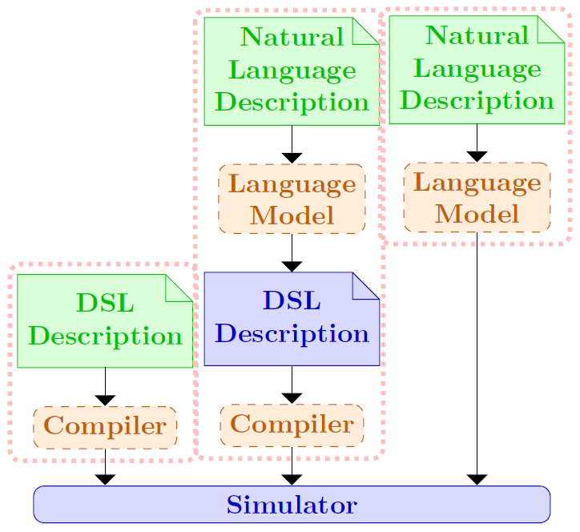
Environment Descriptions

Slide 73
Task generality: principle vs practice
Defining tasks in general-purpose programming language | Defining tasks in a user-friendly language
Only programmers can add new tasks. | Non-programmers can add new tasks.
Even programmers are limited in how many new tasks they can add. | Experienced users can add lots of new tasks.
Can optimise for efficiency (CPU time, memory). | Likely loss in performance.
In principle, we can program any task we want. | Can only define tasks that are supported by language of choice.

Slide 74
Generalisation in AI

Slide 75
My definition of Generalisation in AI
“Generalisation” refers to the extent to which a technique can effectively generalise from observed situations to unseen ones.

Slide 76
My definition of Generalisation in AI
“Generalisation” refers to the extent to which a technique can effectively generalise from observed situations to unseen ones.
This is usually (always?) in a Machine Learning context

Slide 77

Generalisation with respect to transformations
Image 1
Image 2
A cat looks like a cat, regardless of whether it is in the left or right part of an image

Slide 78

Generalisation with respect to transformations
This intuition does not only hold for complete objects such as cats, but also smaller patterns such as faces, ears, noses, circles, edges, curves, lines, and so on

Slide 79
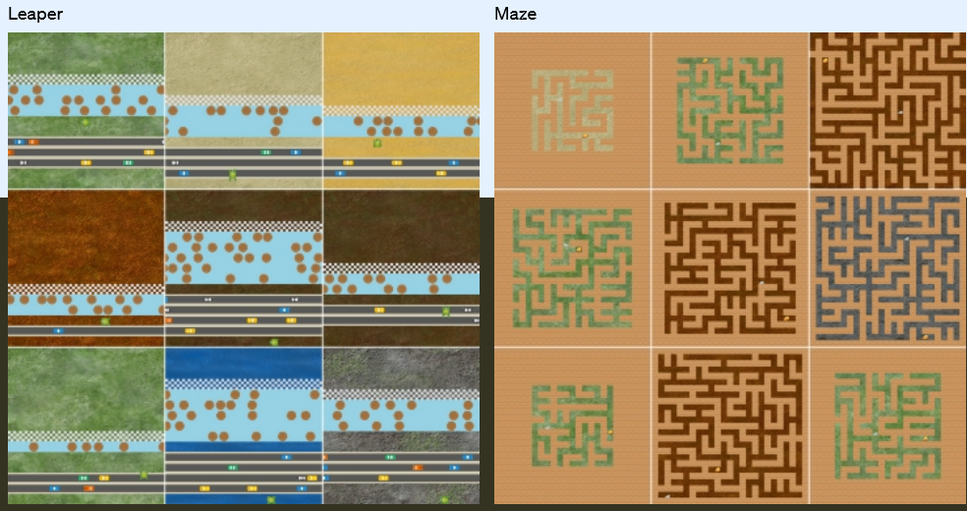
Generalising to different video game levels

Slide 80
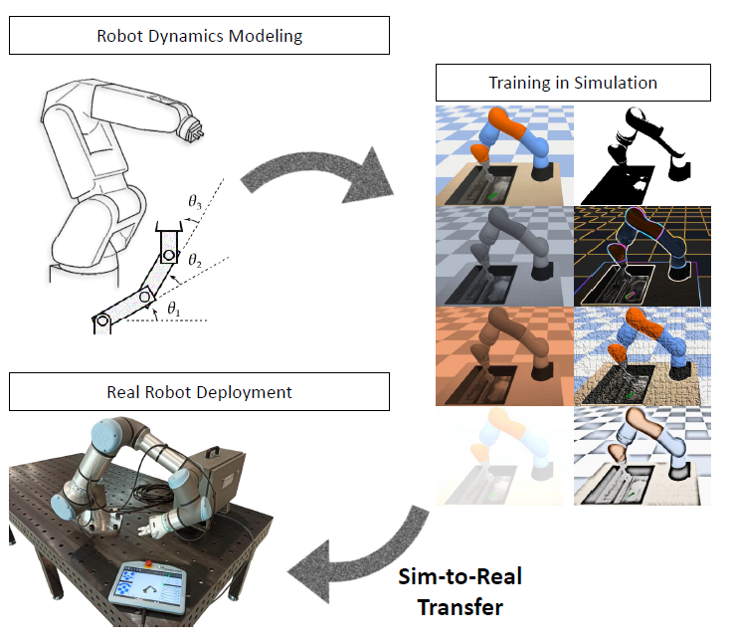
Generalising from simulation to reality

Slide 81
Generalising from simulation to reality
In this case, we hope that we don’t need to generalise much: if simulator is perfect, no need! But, usually, it’s not perfect ☹

Slide 82
Generalising strategies between board games

Slide 83
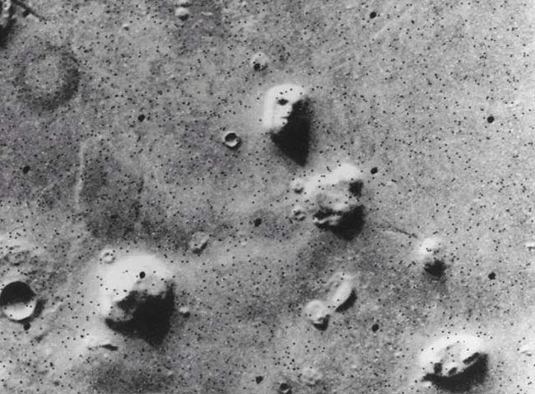
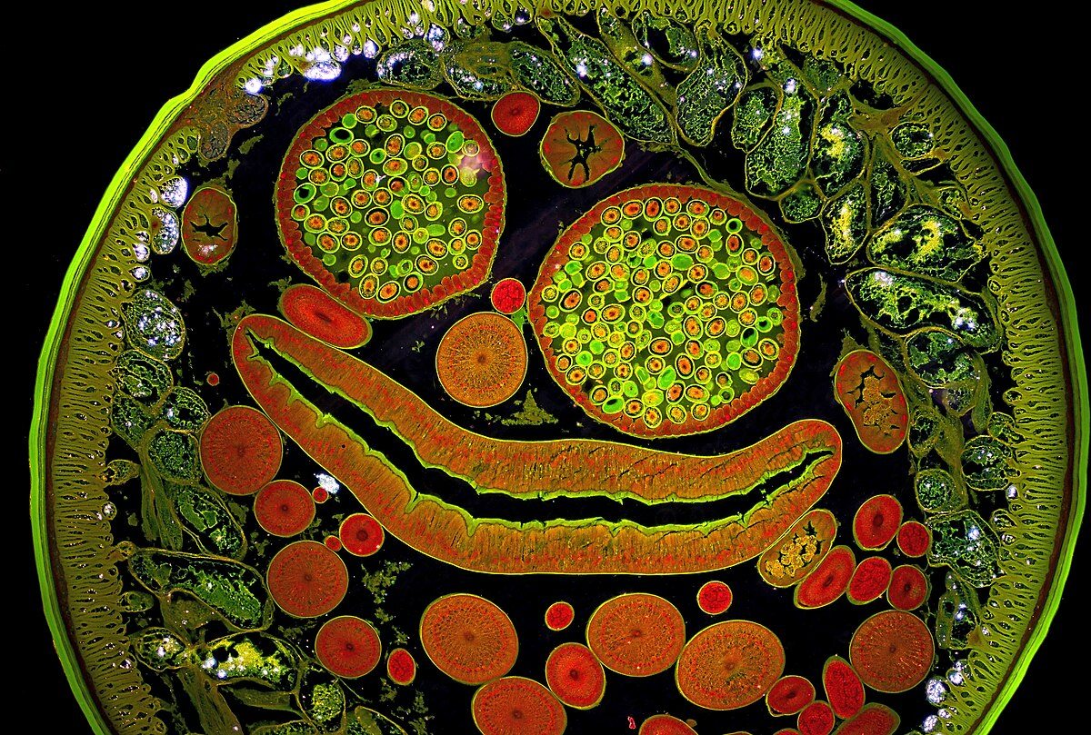
Humans also generalise… a lot
Cross-section of an Ascaris worm (source: Wikipedia)
Source: NASA

Slide 84
Humans also generalise… a lot
Drawing conclusions too quickly based on too few / the wrong features: generalisation gone wrong

Slide 85
Humans also generalise… a lot
Drawing conclusions too quickly based on too few / the wrong features: generalisation gone wrong
Racism
Sexism
Classism
Ageism
…

Slide 86
Humans also generalise… a lot
Drawing conclusions too quickly based on too few / the wrong features: generalisation gone wrong
Racism
Sexism
Classism
Ageism
…
So: if we want to generalise “correctly”, we need: (1) the correct features
(2) sufficiently many and varied examples to learn from

Slide 87
Why do we want generalisation?
1. Generalisation improves learning speed / efficiency.

Slide 88
Why do we want generalisation?
1. Generalisation improves learning speed / efficiency.
2. Generalisation improves generality.

Slide 89
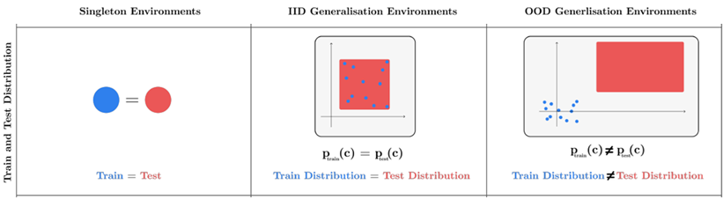
Out-of-distribution generalisation
Source: R. Kirk, A. Zhang, E. Grefenstette and T. Rocktäschel (2023). “A Survey of Zero-shot Generalisation in Deep Reinforcement Learning”. JAIR.

Slide 90
Is it possible to generalise out-of-distribution?
Thanks to Spyridon Samothrakis for image!

Slide 91
Is it possible to generalise out-of-distribution?
Thanks to Spyridon Samothrakis for image!

Slide 92
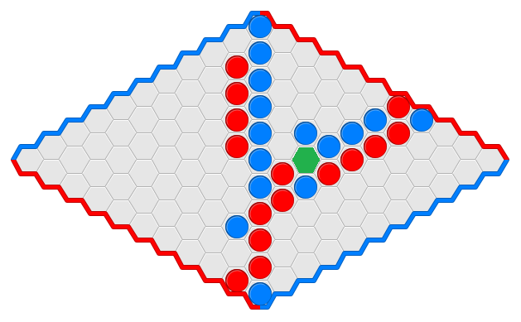
Is it possible to generalise out-of-distribution?
Red is the next player to move. Should they place their next stone in the green cell?

Slide 93
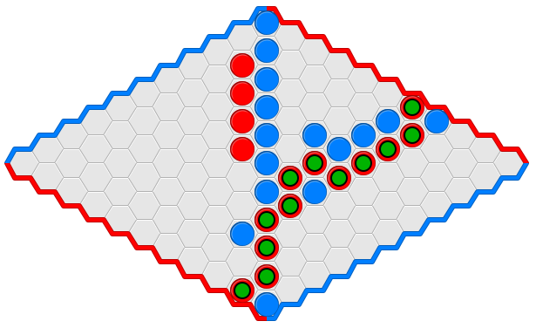
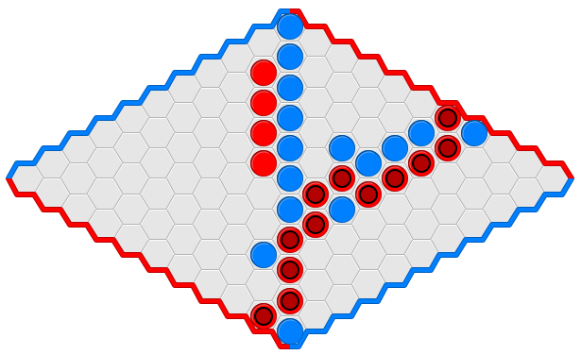
Is it possible to generalise out-of-distribution?
Hex
Misère Hex

Slide 94
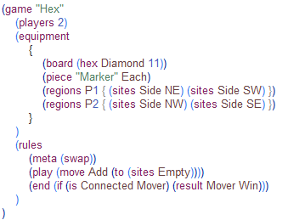
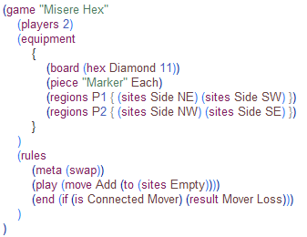
Contexts for Task Disambiguation
Hex
Misère Hex

Slide 95
Contexts for Task Disambiguation
Hex
Misère Hex
Hex was invented by Piet Hein in 1942 then described again by John Nash in 1944. It is played on a rhombus tiled by hexagons, most commonly 11x11 in size. Players take turns placing a piece of their colour at an empty cell, and win by connecting their board sides with a chain of their pieces.
Hex was invented by Piet Hein in 1942 then described again by John Nash in 1944. It is played on a rhombus tiled by hexagons, most commonly 11x11 in size. Players take turns placing a piece of their colour at an empty cell, and lose by connecting their board sides with a chain of their pieces.

Slide 96
Main Takeaways

Slide 97
1: Be honest and precise about the assumptions of your methods and implementation, and impact on generality.

Slide 98
2: Practicality is also important.

Slide 99
3: There can be trade-offs between generality in principle, and ease of implementation across a wide variety of tasks in practice.

Slide 100
4: We often don’t truly care about 100% generality, but rather about generality within a restricted domain of interest.

Slide 101
5: We often don’t truly care about 100% generalisation, but rather about generalisation within a restricted domain of interest.

Slide 102
6: Providing context about the task at hand may be crucial for “out-of-distribution” generalisation.

Slide 103
References
David Silver et al. (2018). “A general reinforcement learning algorithm that masters chess, shogi, and Go through self-play”. Science, Vol. 362, pp. 1140–1144.
Ludii general game playing system: https://ludii.games/
Spyridon Samothrakis, Dennis J.N.J. Soemers, and Damian Machlanski (2024). “Games of Knightian Uncertainty as AGI testbeds”. In 2024 IEEE Conference on Games (CoG 2024), pp. 1–4.
Dennis J. N. J. Soemers, Spyridon Samothrakis, Kurt Driessens, and Mark H. M. Winands (2025). “Environment Descriptions for Usability and Generalisation in Reinforcement Learning”. In Proceedings of the 17th International Conference on Agents and Artificial Intelligence, Vol. 3, pp. 983–992.

Slide 104
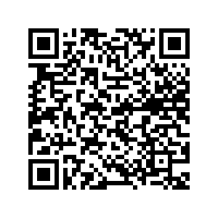
Questions???
Scan the QR code to download these slides:

